Slide 1
Artwork Until Grievances Against Governor Wood
Presented by: Group 5
John Alfred Butnande Patrick Martin Castro Young Seo Park Sean Kenneth Arenal Hover Tiangchon
Professor: Syvel Silvestre

Slide 2
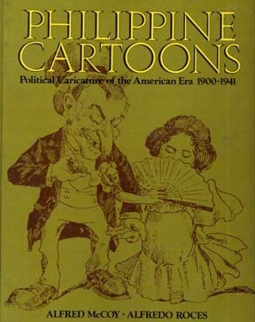
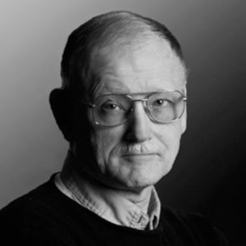
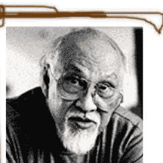
Authors
Alfred W. Mccoy
Alfredo R. Roces
is an American historian and educator. He is the Fred Harvey Harrington Professor of History at the University of Wisconsin–Madison.
is a Filipino Postwar & Contemporary painter who was born in 1932 who started with a figurative style but soon began to amalgamate Expressionism, Fauvism and Impressionism in his paintings.

Slide 3
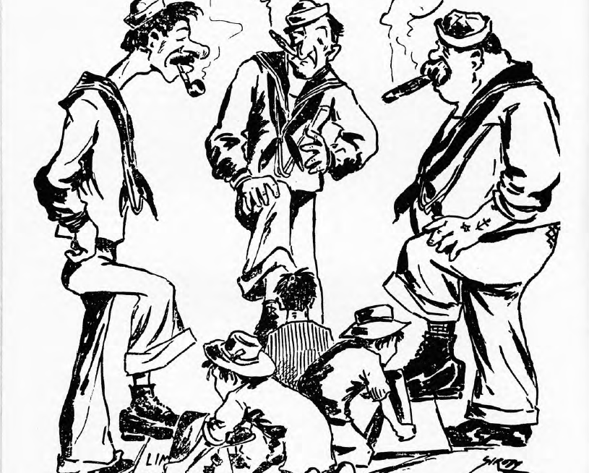
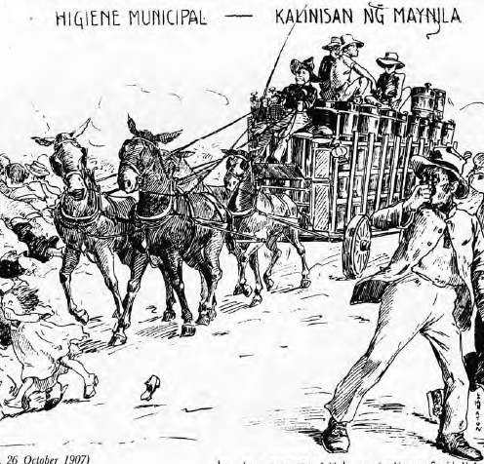
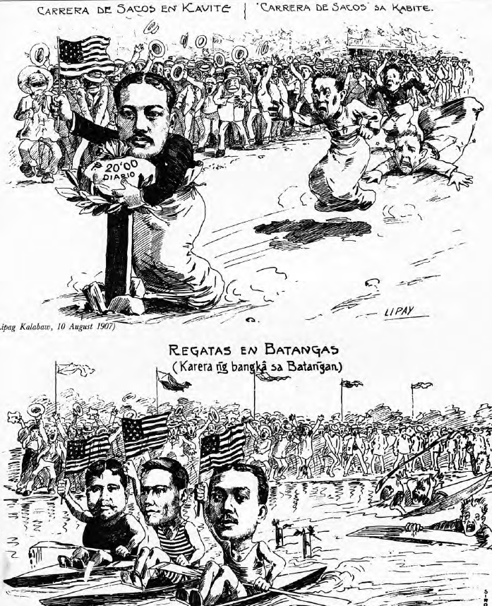
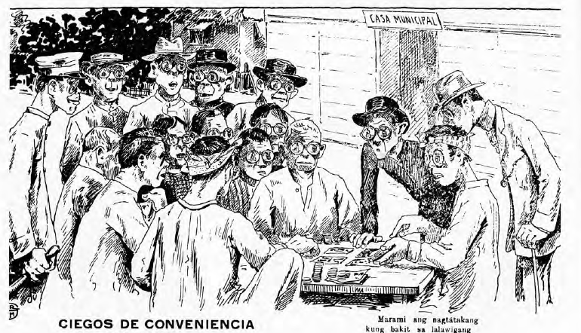
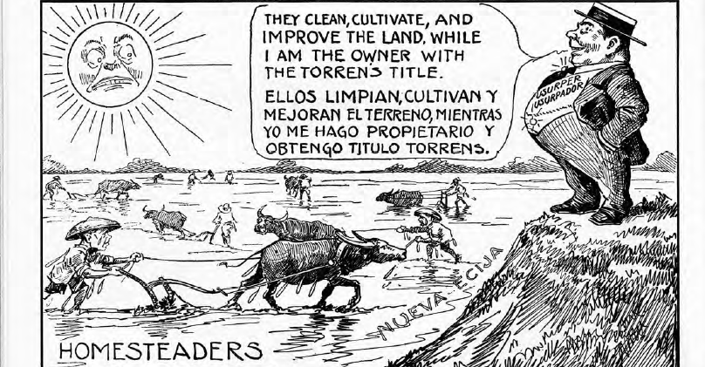
Caricatures?
comically distorted drawing or likeness, done with the purpose of satirizing or ridiculing its subject.
Cartoons are used today primarily for conveying political commentary and editorial opinion in newspapers and for social comedy and visual wit in magazines.

Slide 4
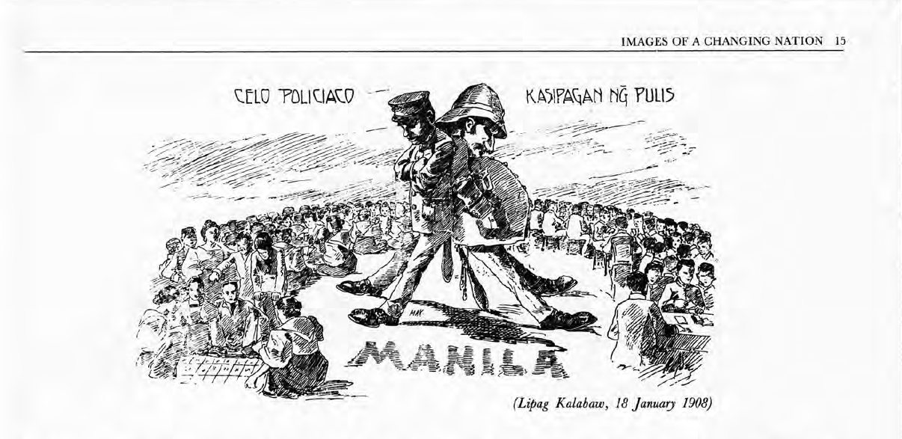
The Cartoons
The Corruption of a City
The Distant Provinces
The Colonial Condition
Uncle Sam and Little Juan
The Aliens in our Midst
The Political Pageant
An Emerging Nation

Slide 5
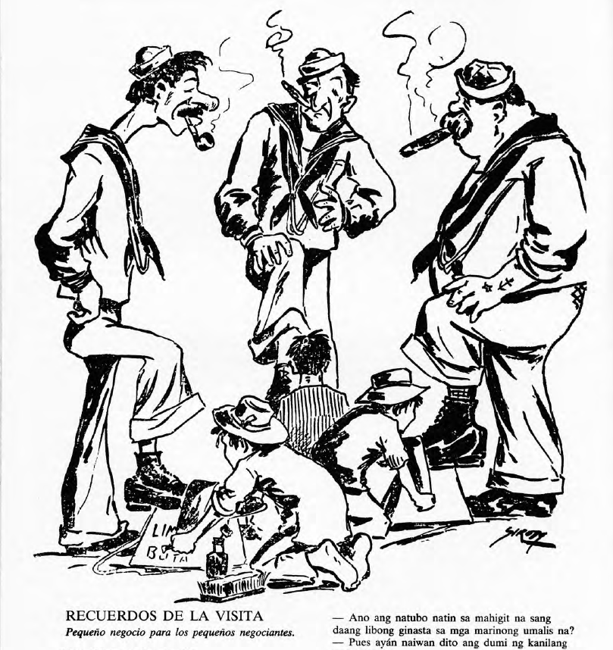
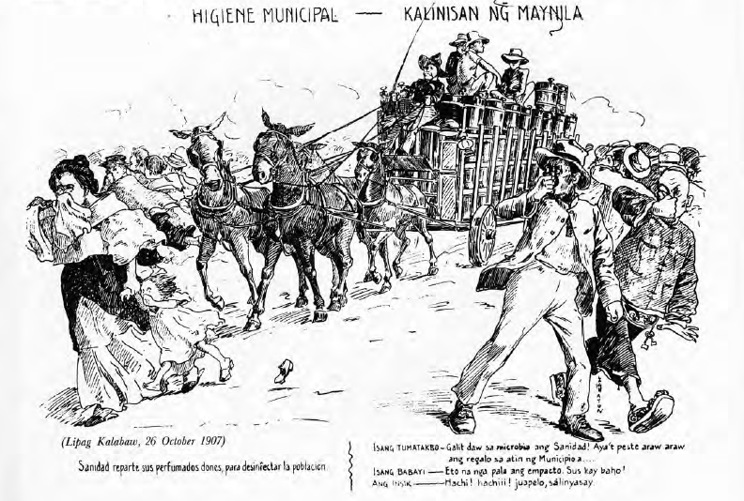
The Corruption of a City
Memories of the Visit
Municipal Hygiene

Slide 6
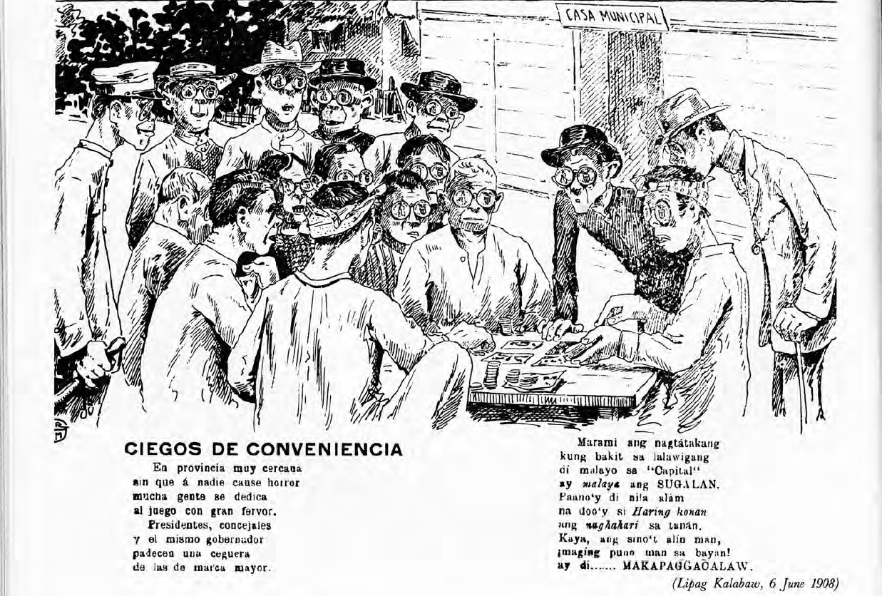
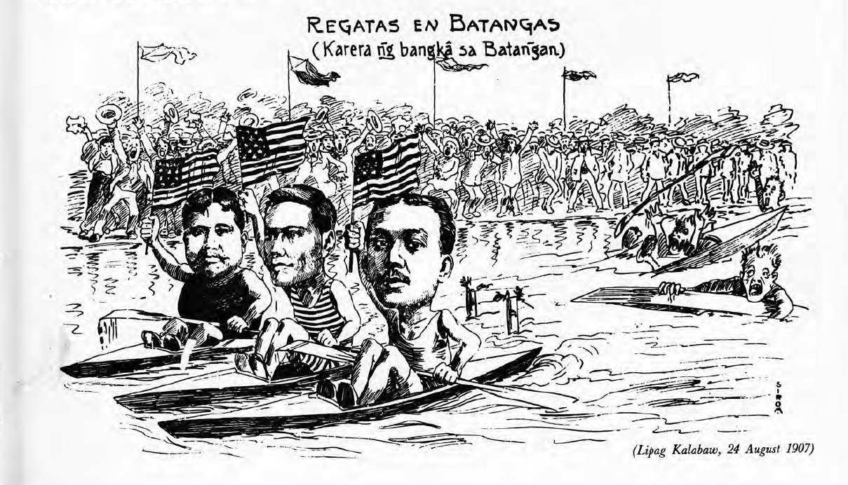
The Distant Provinces
Convenient Blindness
Regattas in Batangas

Slide 7
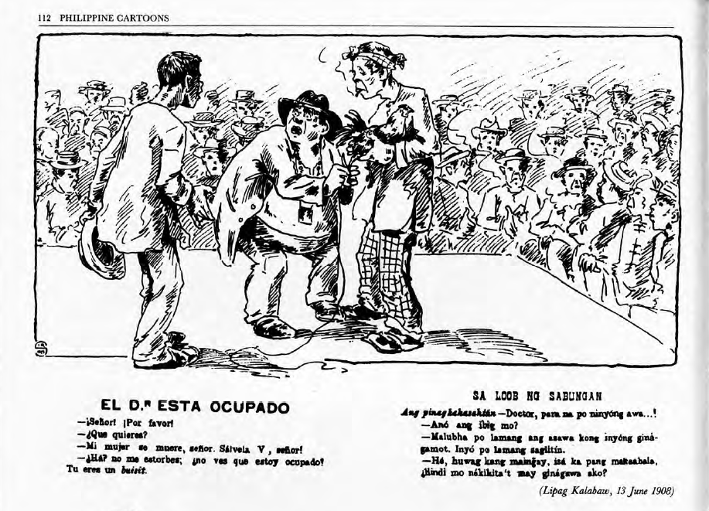
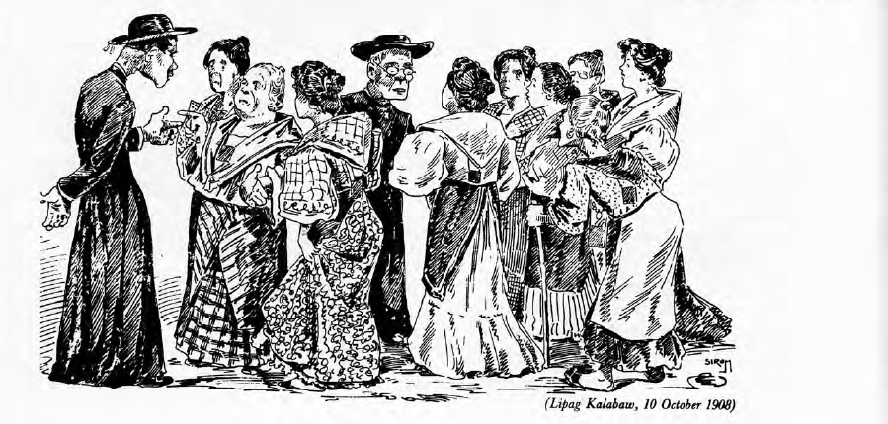
The Colonial Condition
The Doctor is Busy
A Mass is Better

Slide 8
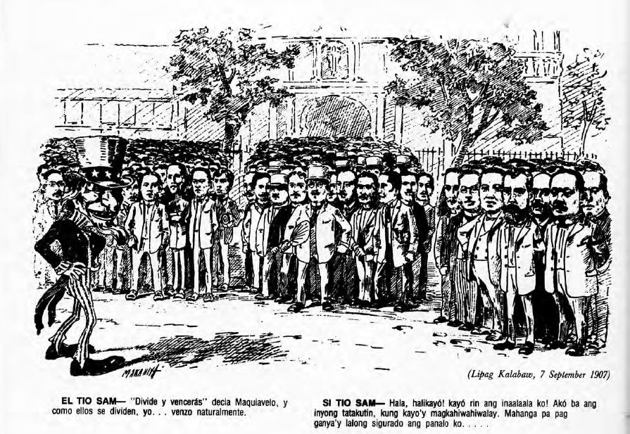
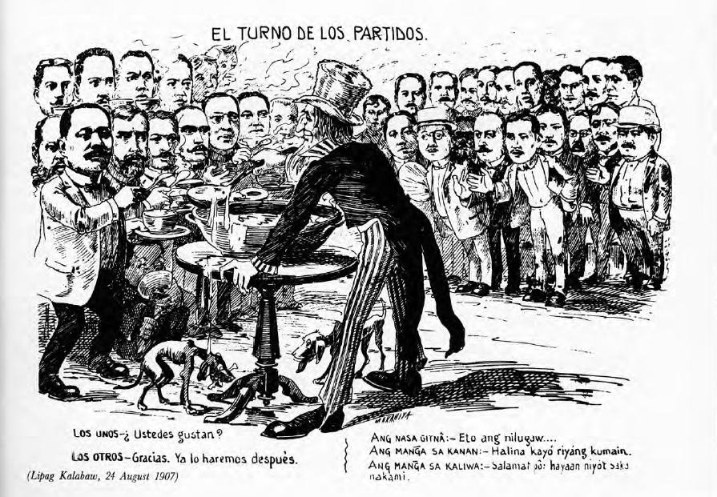
Uncle Sam and Little Juan
Inmediatistas, Unionistas and Urgentistas
The Parties Take Turns

Slide 9
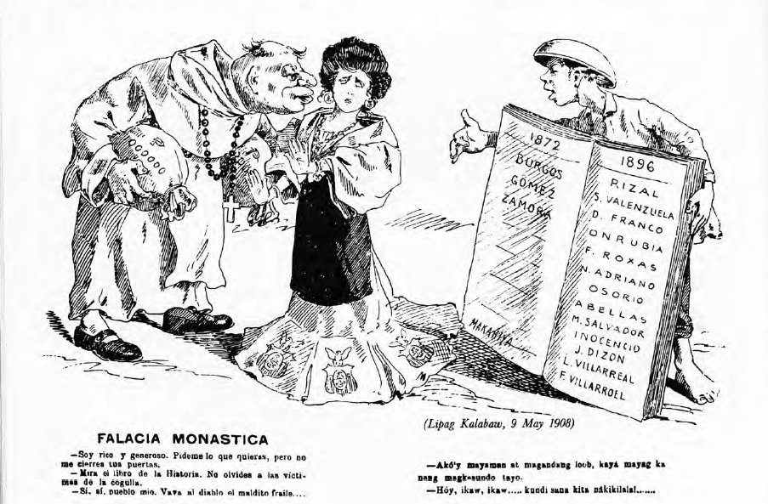
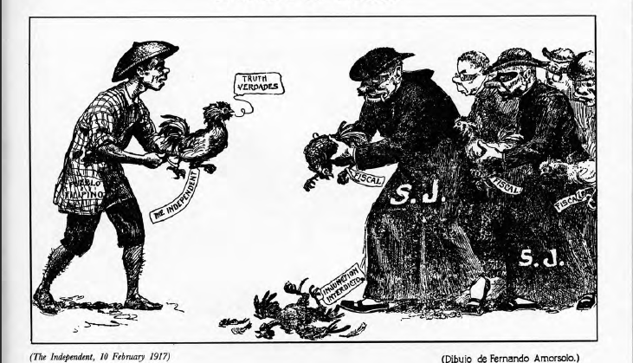
The Aliens in our Midst
Friar Deceit
A Duel To Death

Slide 10
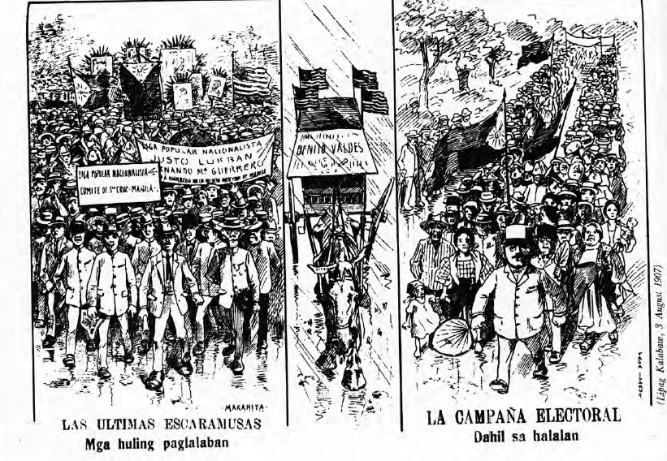
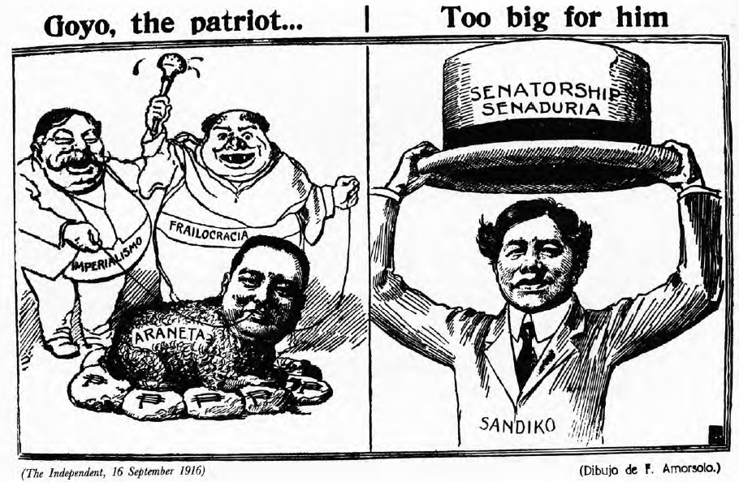
The Politician Pageant
The Electoral Campaign
Goyo The Patriot

Slide 11
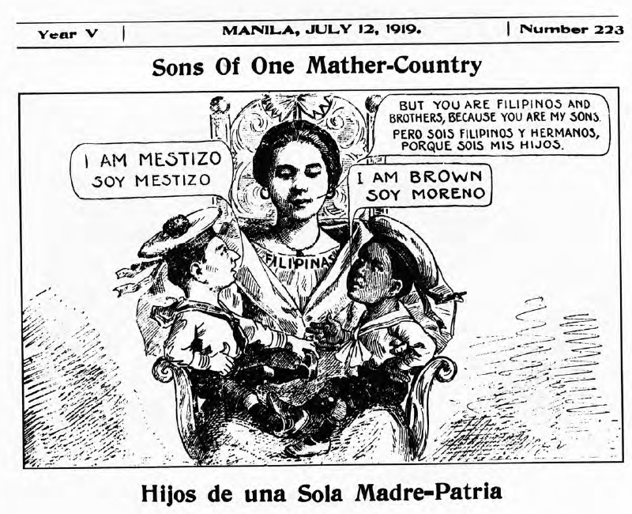
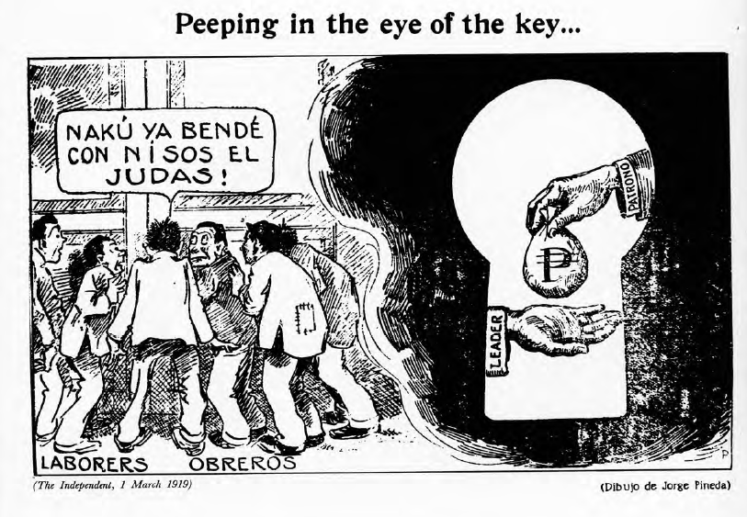
An Emerging Nation
Sons Of One Mather-Country
Peeping Into The Eye Of The Key

Slide 12
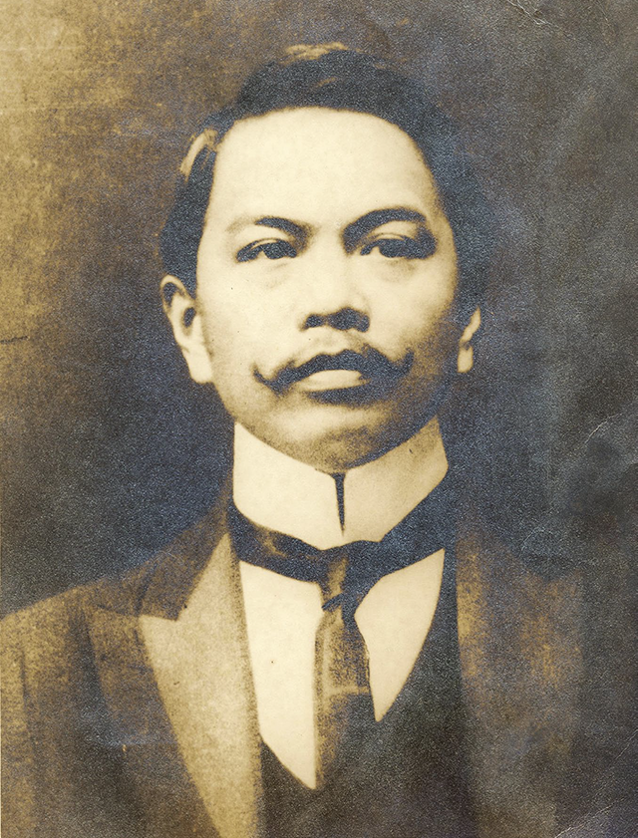
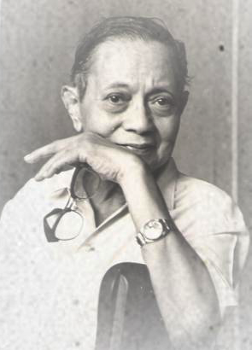
Works of Luna and Amorsolo
Juan Luna de San Pedro Y Novicio Ancheta
Filipino Painter, sculptor and a political activist
First Internationally Known Painter
Born on October 23, 1857 in Ilocos Norte
He Studied at Art School of the Liceo de Manila University of the Philippines and School of Fine Arts Academia de San Fernando (in Madrid)
Fernando Cuerto Amorsolo
portraitist and painter of rural Philippine landscapes.
Grand Old Man of Philippine Art
he was the first-ever to be recognized as a National Artist of the Philippines
studied at Colegio de San Juan de Letran but wasn't able to finish his studies due to outbreak of cholera in 1882.
Juan Luna
Fernando Amorsolo

Slide 13
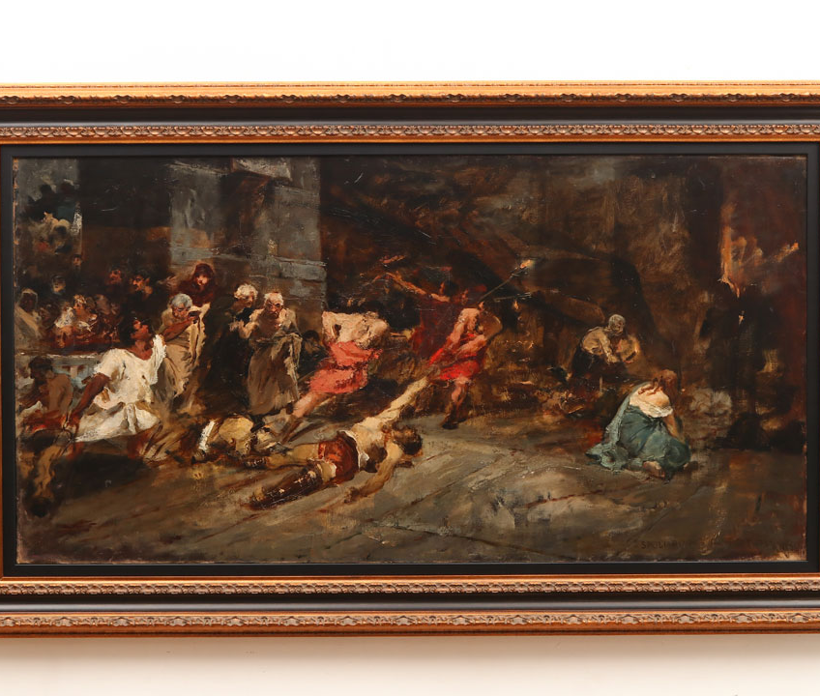
SPOLIARIUM
Spoliarium is a Latin word referring to the basement of the Roman Colosseum where the fallen and dying gladiators are dumped and devoid of their worldly possessions.

Slide 14
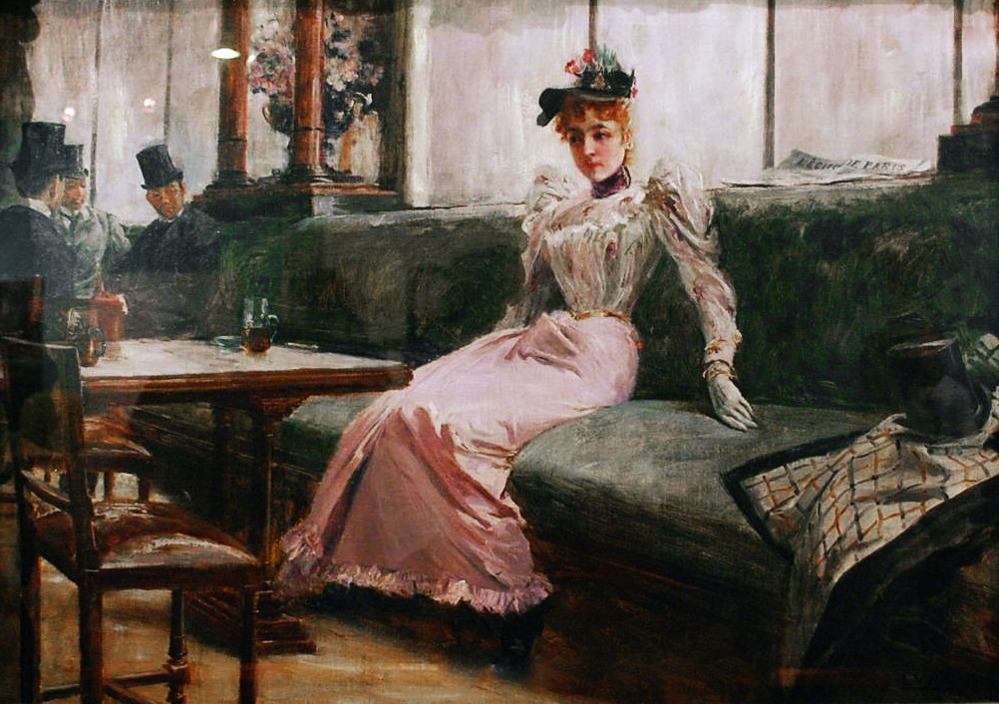
THE PARISIAN LIFE
The Parisian Life does not solely embody the “intangible ideas of the Filipino national consciousness” but also Luna's talent as an artist. The Parisian Life painting proves that Luna is an “indefatigable painter of women”.

Slide 15
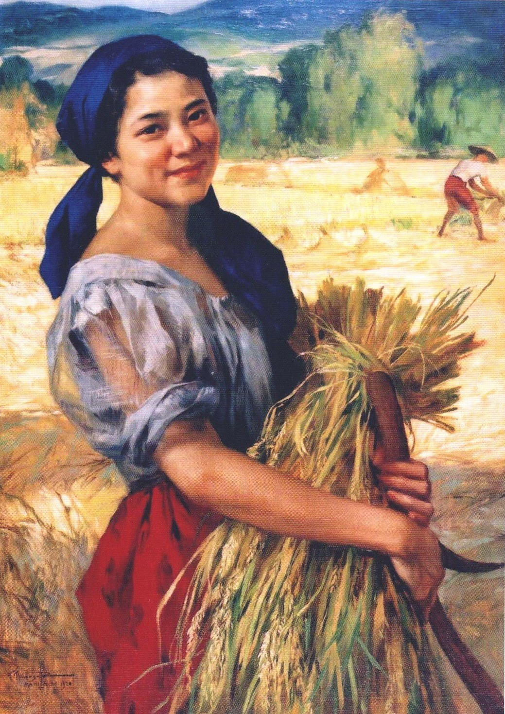
THE PALAY MAIDEN
Amorsolo's 1920 masterpiece “Palay Maiden” celebrated the Filipina in her own likeness, carrying new harvest to symbolize the hope for a rising nation.

Slide 16
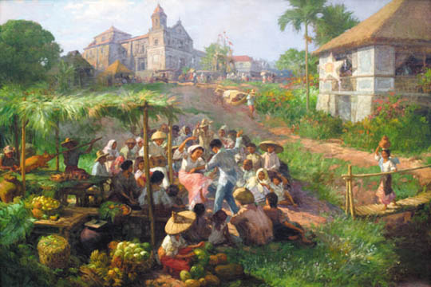
ANTIPOLO FIESTA
This oil painting on canvas by amorsolo depicts a rural scene where a group of people are shown celebrating a fiesta in Antipolo. The main focus is on a pair of dancers in the field surrounded by revelers both young and old. Abundant food is presented in basketfuls of assorted fruits on the benches and on the ground, as well as the traditional roasted pig or lechon being prepared by two men.

Slide 17
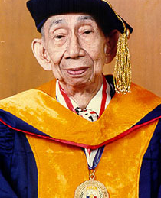
Filipino Grievances Against Governor Wood
Gregorio F. Zaide was a Filipino historian, author and politician from the town of Pagsanan, Laguna in the Philippines. A multi-awarded author, Zaide wrote 67 books and more than 500 articles about history, he is known as the "Dean of Filipino Historiographers.“.

Slide 18
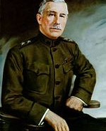
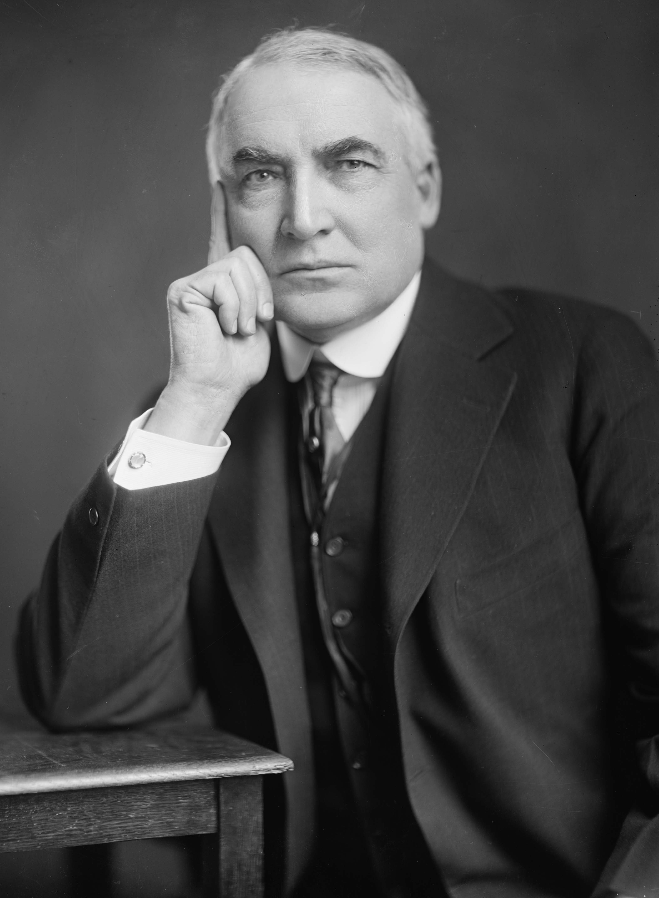
Gov. Gen. Leonardo Wood
Wood was a United States Army major general, physician and public official.
He graduated in Harvard medical school and conscripted to the U.S army as medical doctor.
A Military governor in Cuba(1899-1902) and Mindanao (1903)
Wood commanded the Philippine Division of U.S Army (1906-1908)
A republican candidate for presidency but lost in nomination to warren harding (1920)
Wood was governor general of the Philippines from 1921 to 1927
Warren G. Harding
Wood was Sent to the Philippines by President Harding to serve on a special Mission. Wood carried out a one-year appointment as Governor General of the Philippines in 1921.

Slide 19
Expectations and Reality
Cognizant of General Wood's participation in the liberation of Cuba, Filipinos expected that spirit of cooperation would be maintained amongst the Filipinos and Americans. Political emancipation would be complete.
It turns out that under his administration, the expectations that they had were the exact opposite. Governor Wood has abused his authority which caused a lot of difficulties for the Filipinos. There was a train of usurpation & arbitrary acts Resulted in curtailment of our autonomy & destruction of our constitutional system Reversal of America's Philippine Policy

Slide 20
Arbitrary Acts
He has refused his assent to laws which were the most wholesome & necessary heads of department.
He has set at naught both the legal authority and responsibility for the Philippine heads of departments.
He has substituted his constitutional advisers for a group of military attaches without legal standing in the government and not responsible to the people.
He has reversed the policy of Filipinizing the service of the government by appointing Americans even when Filipinos of proven capacity were available.
He has obstructed the carrying out of national economic policies duty adopted by the Legislature, merely because they are in conflict with his personal views.
He has rendered merely perfunctory the power of the Legislature to pass the annual appropriation law by reviving items in the law of the preceding year, after vetoing the corresponding items of the current appropriation act, in the flagrant violation for Organic Law.
He has made appointments to positions and authorized the payment of salaries therefore after having vetoed the appropriations of such salaries.
He has used certain public funds to grant additional compensation to public officials in clear violation law.
He has arrogated unto himself the right of exercising the powers granted by law to the Emergency Board after abolishing said board on the ground that its powers involved an unlawful delegation of legislative authority.
He has unduly interfered in the administration of justice.

Slide 21
Arbitrary Acts
He has refused to obtain the advice of the Senate in making appointments where such advice is required by the Organic Act.
He has refused to submit the Senate appointment for vacancies occurring during the recess of the Legislature in contravention of the Organic Act.
He has continued in office nominees whose appointments had been rejected by the Senate.
He has usurped legislative powers by imposing conditions on legislative measures approved by him.
He has, in the administration of affairs in Mindanao, brought about a condition which has given rise to discord and dissension between certain groups of Christian and Mohammedan Filipinos.
He has by his policies created strained relations between resident Americans and Filipinos.
He has endeavored, on the pretext of getting the government out of business, to dispose of all the companies capitalized by the government worth many millions of the people's money to powerful America interests.
He has sanctioned the campaign of insidious propaganda in the United States against Filipino people and their aspirations.
He has attempted to close the Philippine National Bank so necessary to the economic development of the country.
He has adopted the practice of intervening in, and controlling directly, to its minute details, the affairs of the Philippine Government both insular and local, in violation of self-government.
He has insistently sought the amendment of our laws approved by the Congress of the United Stated, which amendment would open up the resources of our country to exploitation by predatory interests.

Slide 22
The Protest
"In the face of this critical situation, we, the constitutional representatives of the Filipino people, met to deliberate upon the present difficulties existing in the Government of the Philippine Islands and to determine how best to preserve the supremacy and majesty of the laws and to safeguard the right and liberties of our people, having faith in the sense of justice of the people of the United States and inspired by her patriotic example in the early days of her history, do hereby, in our behalf and in the name of the Filipino people, solemnly and publicly make known our most vigorous protest against the arbitrary acts and usurpations of the present Governor-General of the Philippine Islands, particularly against Executive Order No. 37."

Slide 23
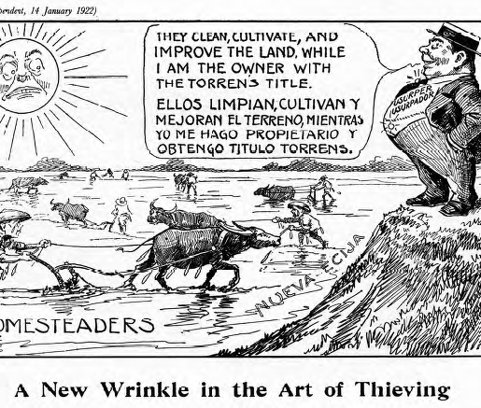
Contribution and relevance of the document in understanding the grand narrative of Philippine history. (Political Cartoons)
VIEWED FROM THE VANTAGE point of a half century and more, these prewar political cartoons are an evocative record of a half-forgotten history. The scandals, struggles and social changes of the American colonial period gain an immediacy in these graphic images that eludes even the most eloquent historical prose. For those who drew and published them, these cartoons were simultaneously a mirror of their society's colonial condition, an act of protest, and a weapon in the struggle for social reform.
The four decades of American colonial rule were a formative period in Philippine history. Under a U.S. colonialism that was simultaneously brutal and beneficent, grasping and generous, the Philippines moved forward from an authoritarian Spanish regime to autonomy and independence. In the process, Filipinos shaped many of the institutions and cultural characteristics which are still central to life in the modern republic. Under U.S. colonial tutelage, the Philippines experienced a process of Americanization and modernization that has left a lasting legacy.

Slide 24
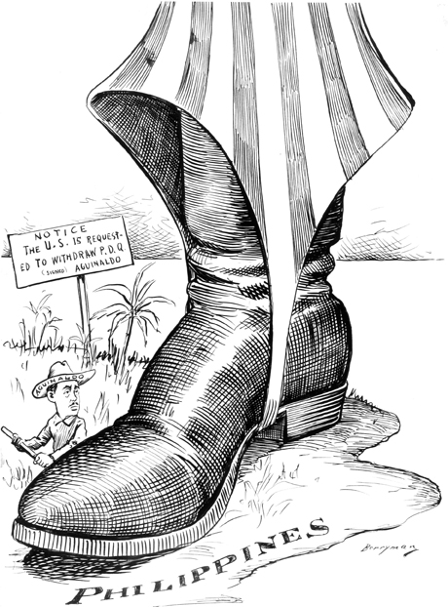
Contribution and relevance of the document in understanding the grand narrative of Philippine history. (Grievances against Wood)
Gave us essential information from the foreign colonization of the Philippines
It also helps clarify the situations of the Filipino people under the Spanish regime.
The document served as an impeachment request for Governor Wood.
A year after this document was approved, Governor Leonard Wood, died due to surgery failure.
Showed only brief preview and on the important events that happened in the Philippine history.

Slide 25
Thank you!!
References:
Filipino grievance against governor wood - Pdfcoffee.com. (2020, October 25). pdfcoffee.com. https://pdfcoffee.com/filipino-grievance-against-governor-wood-pdf-free.html
Leonard wood. (2022, September 13). Wikipedia, the free encyclopedia. Retrieved September 15, 2022, from https://en.wikipedia.org/wiki/Leonard_Wood
McCoy, A. W. (1985). Philippine cartoons: Political caricature of the American era, 1900-1941.

